Slide 1

Firebase Introduction
Android Mobile Programming Class 2020
16CN - FIT - HAU
Nhóm G5:
Lê Phương Anh
Trần Thị Thúy Hòa
Trịnh Quang Cường
Hoàng Thị Thùy Dung
Phạm Thị Nga

Slide 2
Content
What is firebase?
Build your app
Grow your app
Improve your app
Demo App, Authentication

Slide 3
What is Firebase?

Slide 4
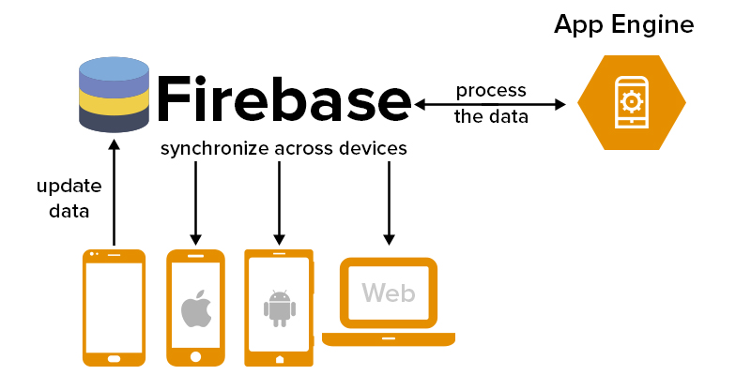
What is Firebase?
Toolset to “build, improve, and grow your app”.
Tools -> services that dev: normally have to build, but don’t really want to build.
Focusing on the app experience itself.
Services are hosted in the cloud, and scale with little to no effort on the part of the developer.

Slide 5
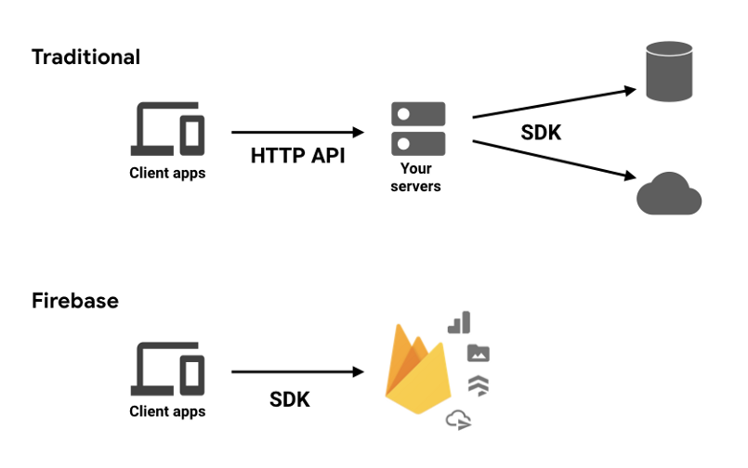
Developing App Traditional vs Firebase
Backend components that are fully maintained and operated by Google.
Client SDKs provided by Firebase interact with these backend services directly
Notes:
This is different than traditional app development, which typically involves writing both frontend and backend software. The frontend code just invokes API endpoints exposed by the backend, and the backend code actually does the work.
However, with Firebase products, the traditional backend is bypassed, putting the work into the client. Administrative access to each of these products is provided by the Firebase console.

Slide 6
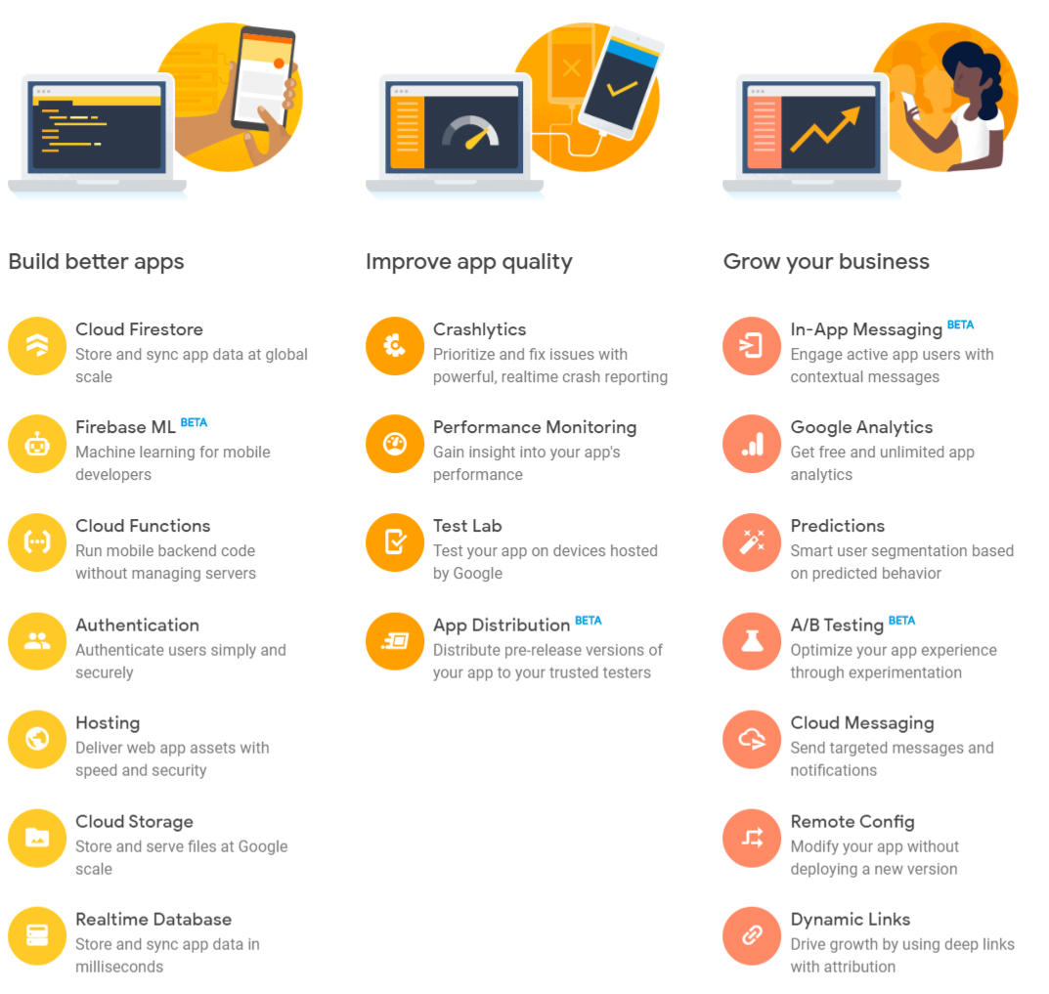
Firebase Suits
Products

Slide 7
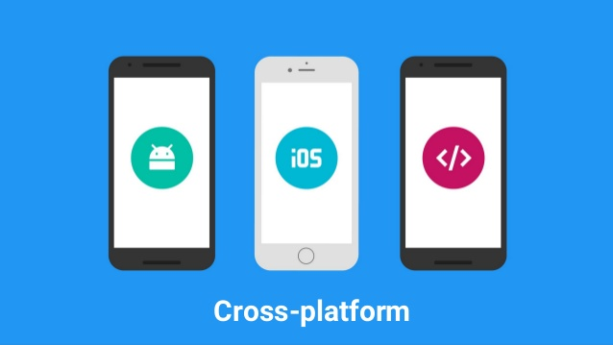
What sort of apps is Firebase good for?
iOS and Android: primary targets.
Increasing support for web, Flutter, Unity, and C++.
FirebaseUI libraries (Android, iOS, web):provides helpful utilities to make development easier.

Slide 8
Build your app
Creating the “GUT”

Slide 9
Build your app
Include 7 product:
Authentication — user login and identity
Realtime Database — realtime, cloud hosted, NoSQL database
Cloud Firestore — realtime, cloud hosted, NoSQL database
Cloud Storage — massively scalable file storage
Cloud Functions — “serverless”, event driven backend
Firebase Hosting — global web hosting
ML Kit —SDK for common ML tasks

Slide 10
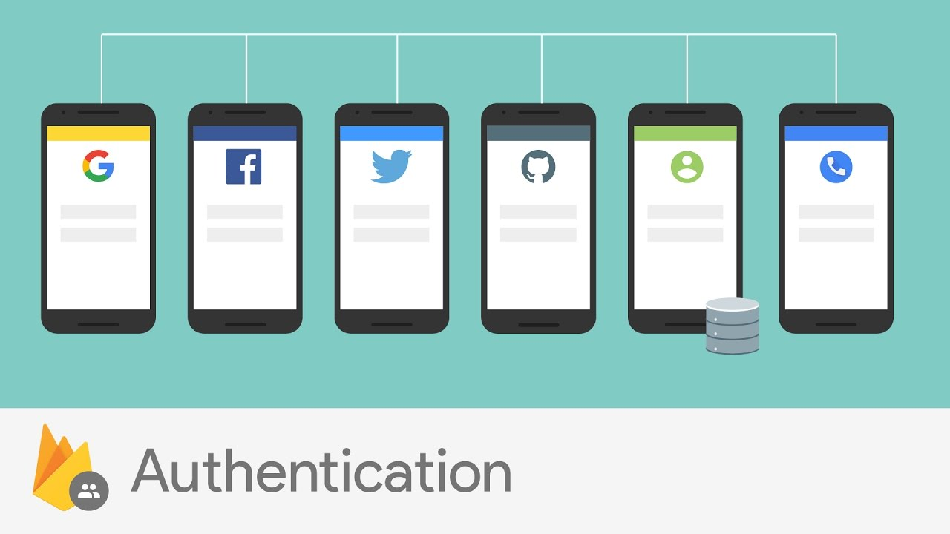
Firebase Authentication
is essential to getting some of the other products configured properly, especially if you need to restrict access to per-user data
easy to perform secure logins, which is incredibly difficult to implement correctly on your own
takes care of getting your users logged in and identified.

Slide 11

Firebase Authentication
“federated identity”
link a user’s accounts from the various identity providers (Facebook, Twitter, Google, GitHub) into a single account on Firebase Authentication
Don’t try to store a user’s password

Slide 12
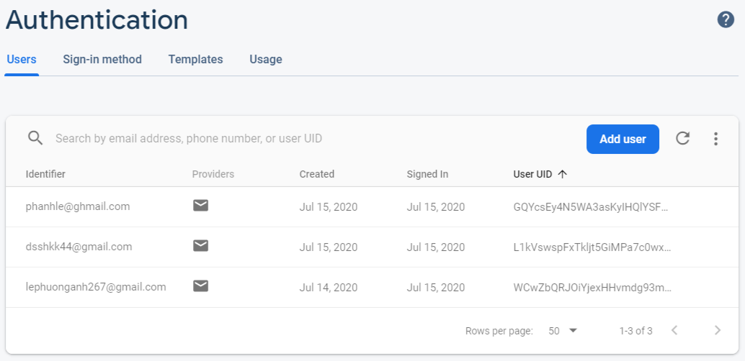

Slide 13
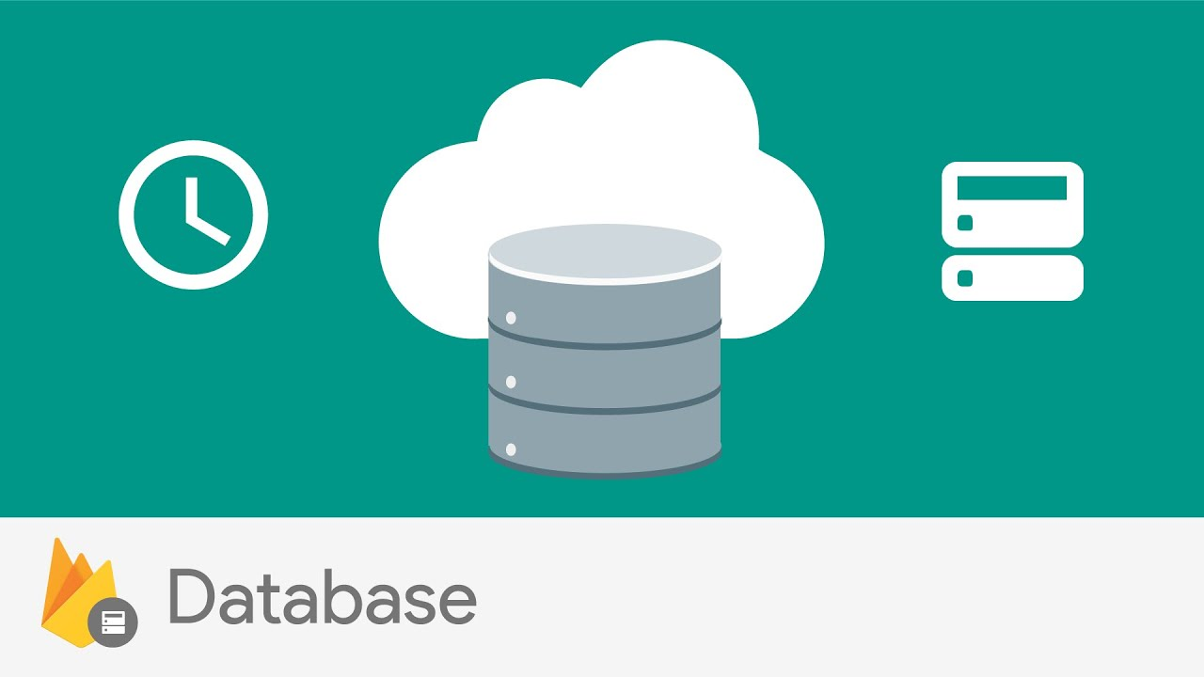
Firebase Realtime DB Cloud Firestore
Firestore is technically a Google Cloud product, not a Firebase product
Firebase adds SDKs to use in your mobile app to make direct data access
provide database services.
realtime, cloud hosted, NoSQL databases
can use either one, or both together

Slide 14
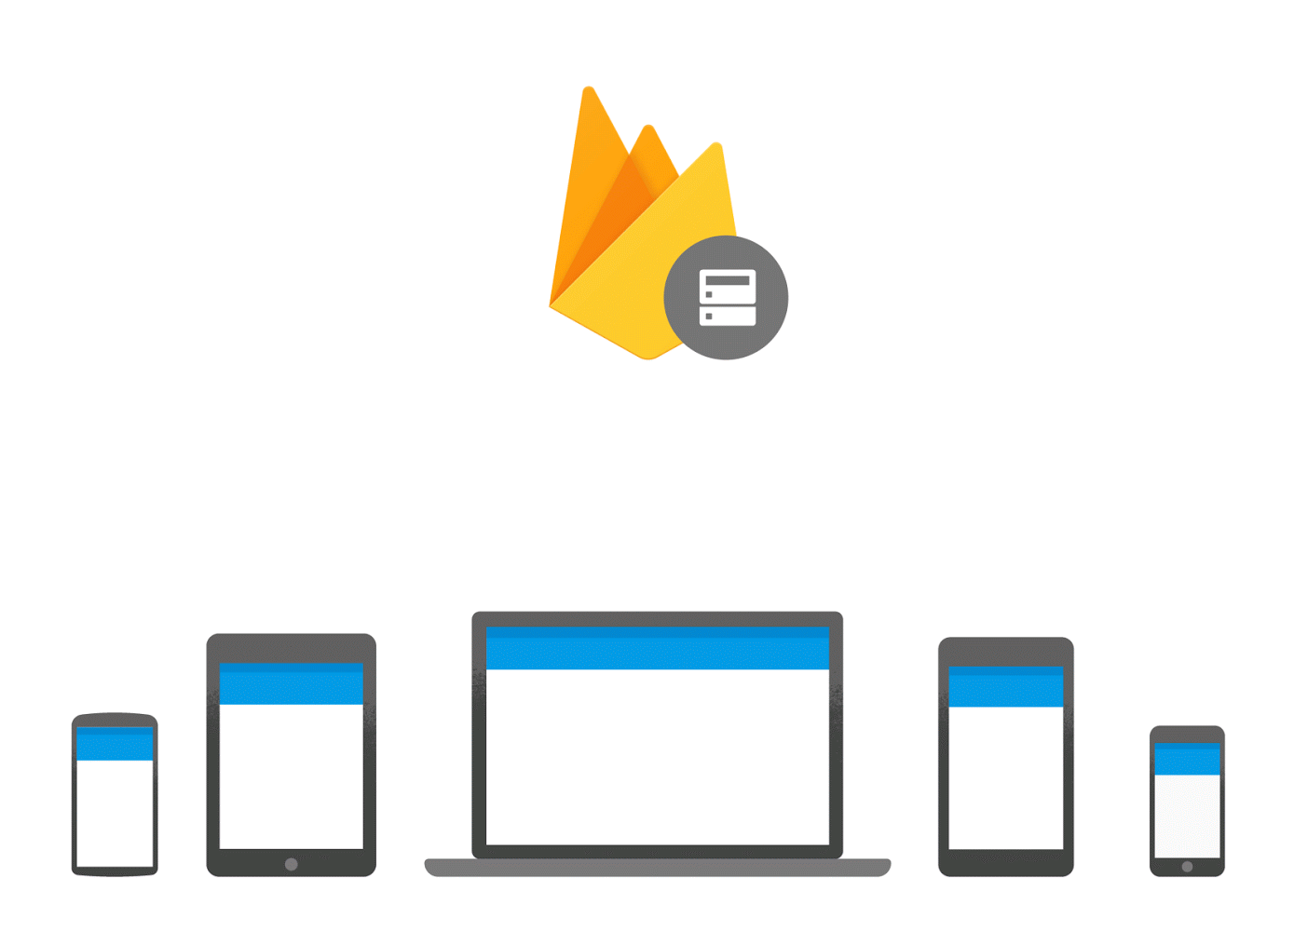
Firebase Realtime DB Cloud Firestore
You use the client SDK to set up a “listener” at the location of the data your app wants to use.
The listener gets invoked with that data repeatedly, every time a change is observed.
This lets you keep your app’s display fresh
“realtime” updates to data as it changes in the database

Slide 15
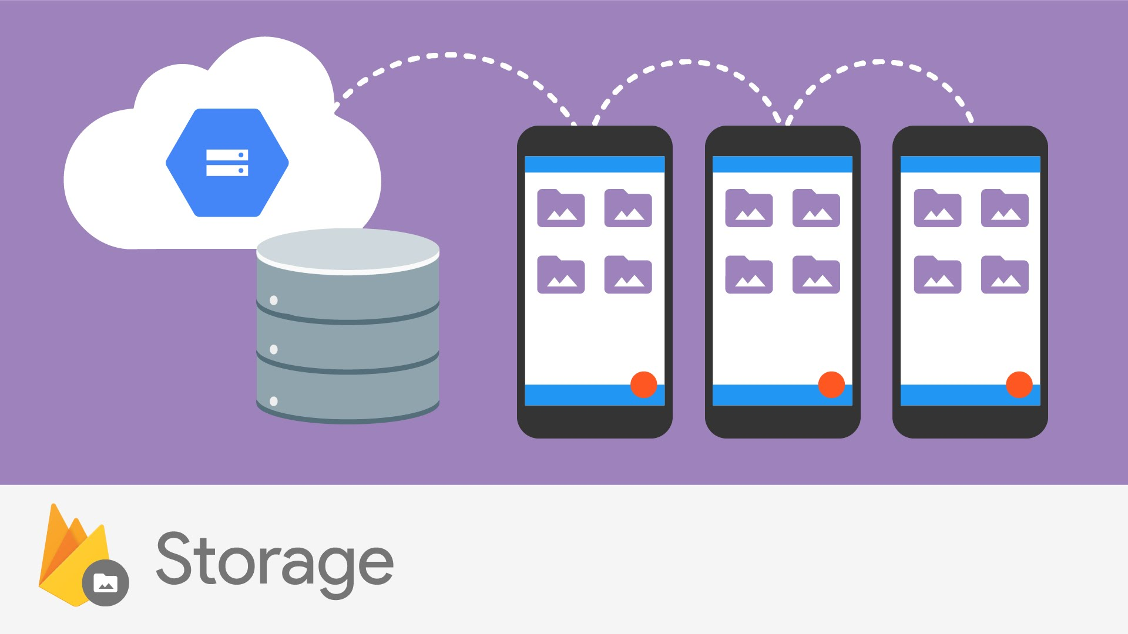
Cloud Storage
Is a Google Cloud product, ! a Firebase product.
With Cloud Storage for Firebase, you get client SDKs to use in your app that enable you to upload and download files directly to and from your Cloud Storage “bucket”.
provides massively scalable file storage
Notes:
“Buckets are the basic containers that hold your data. Everything that you store in Cloud Storage must be contained in a bucket. You can use buckets to organize your data and control access to your data”

Slide 16

Security Rules
This “lolrus” has a Cloud Storage “bucket” that stores “files”. Unfortunately, it didn’t use security rules to protect the contents of the bucket!
Authentication + Security Rules (of Realtime Database, Firestore, and Cloud Storage)
-> set access control to your data at the source.
->clients can access that data only in the ways you all.
Signed in User provide auth token when access to fire
Notes:
Users signed into an app with Authentication will automatically provide an identification token that you can use in your rules to protect who can read and write which items of data.
So, if you store personal data about your users, definitely use Firebase Authentication with security rules to limit access appropriately. You may even get a gentle reminder from Firebase if your rules appear overly permissive.

Slide 17
Cloud Function
Ex: When someone deletes their account
Shawn uses Cloud Functions to automatically delete data from his database and storage
(because user privacy must be protected in many situations, and getting billed for unused data is terrible)
Google “serverless” infrastructure
Backend code
Event trigger
FbAuth
FbStorage
Fb ...
Notes:
is a Google Cloud product that works well with other Firebase and Cloud products. Using the Firebase SDKs for Cloud Functions, you can write and deploy code, running on Google “serverless” infrastructure, that automatically responds to events coming from other Firebase products.

Slide 18
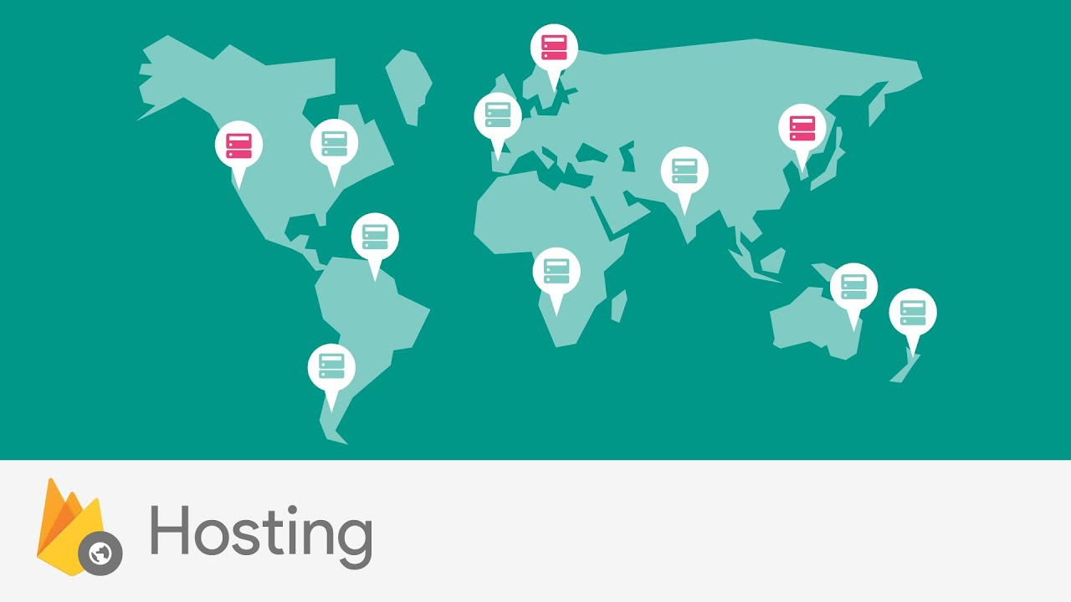
Firebase hosting
secure, global web hosting CDN (Content Delivery Network)

Slide 19
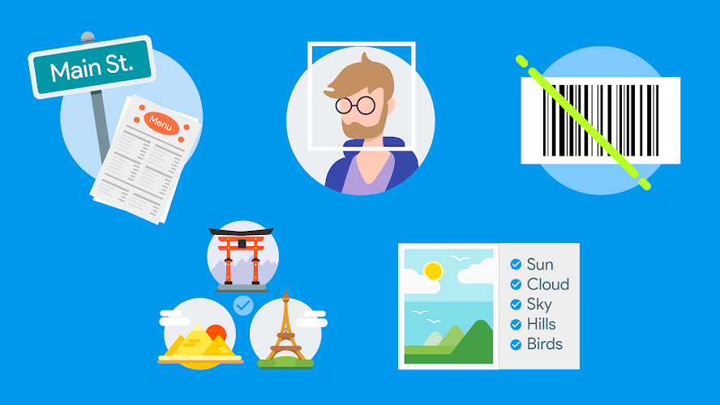
Firebase
ML Kit
Use Machine Learning (ML) without knowing how to build ML application

Slide 20
Grow your app
Attach and Retain user

Slide 21
Grow your app
Analytics
Predictions
Cloud Messaging
Remote Config
A/B Testing
Dynamic Links
App Indexing
In-App Messaging

Slide 22

Analytics
Know your users, how they make use of your app
Firebase collect data
Do it with your intuition can be wrong
audience = group of users = predefined actions (app) + shared user properties + common device characteristics
You define the requirements -> Analytics will figure out which users belong to it
Notes:
“Greta’s game defines an audience of “players who have completed level 10, and made an in-game purchase” (core players). Shawn’s social network app defines an audience of “people between the ages of 18–24, who have at least 50 friends on the network” (social young adults). Once these audiences have been defined in the Firebase console, and apps are updated to send the correct events, the audiences will collect members. Greta and Shawn can then target the audience members with information and offers of interest to these groups.”

Slide 23

Prediction
Aren’t required to do anything to define!
The magic of machine learning!
predictions about which users:
churn (not open your app)
spend (money on your app)

Slide 24
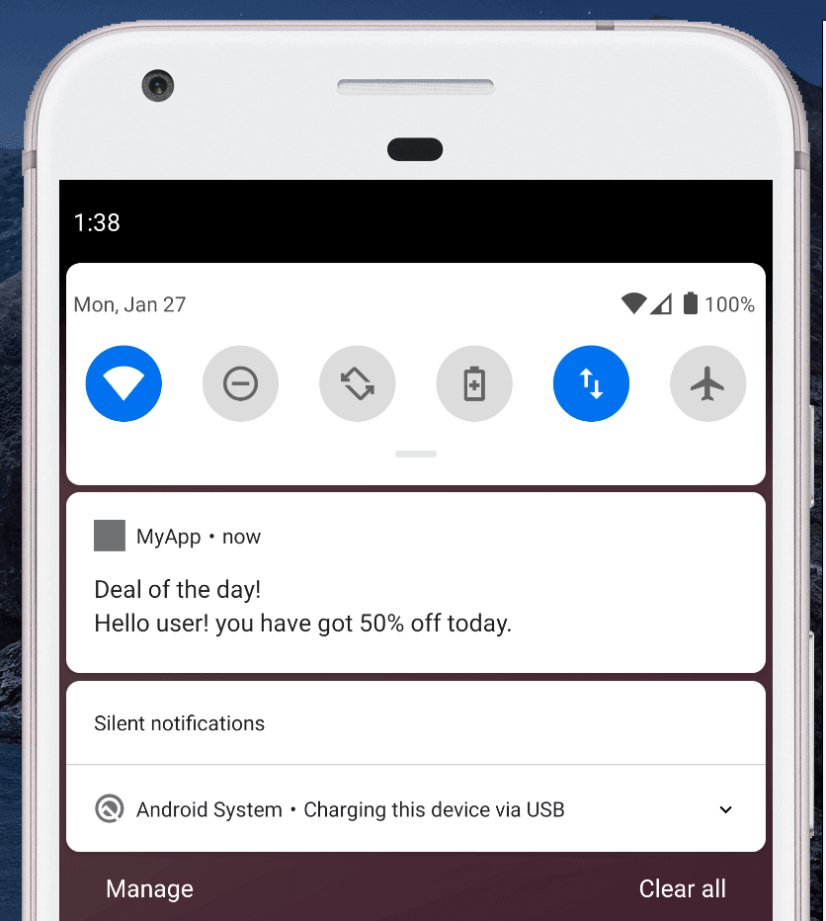
FCM - Firebase
Cloud Messaging
2 ways to send a message:
Backend code -> ping your app when something gets updated (a chat room notification).
Compose a message in Firebase Console -> ping users <- information of interest (direct user notifications).
Send a message to particular
-> Analytics audience vs Predictions groups
deliver push messages to indicate something of interest to your app, or the user
Notes:
Send only relevant and desired messages to your users, at a reasonable frequency.
“Greta might notify her core players audience of new game items for sale. And Shawn might send a reminder to his social young adults to rate and discuss their favorite night clubs.”

Slide 25
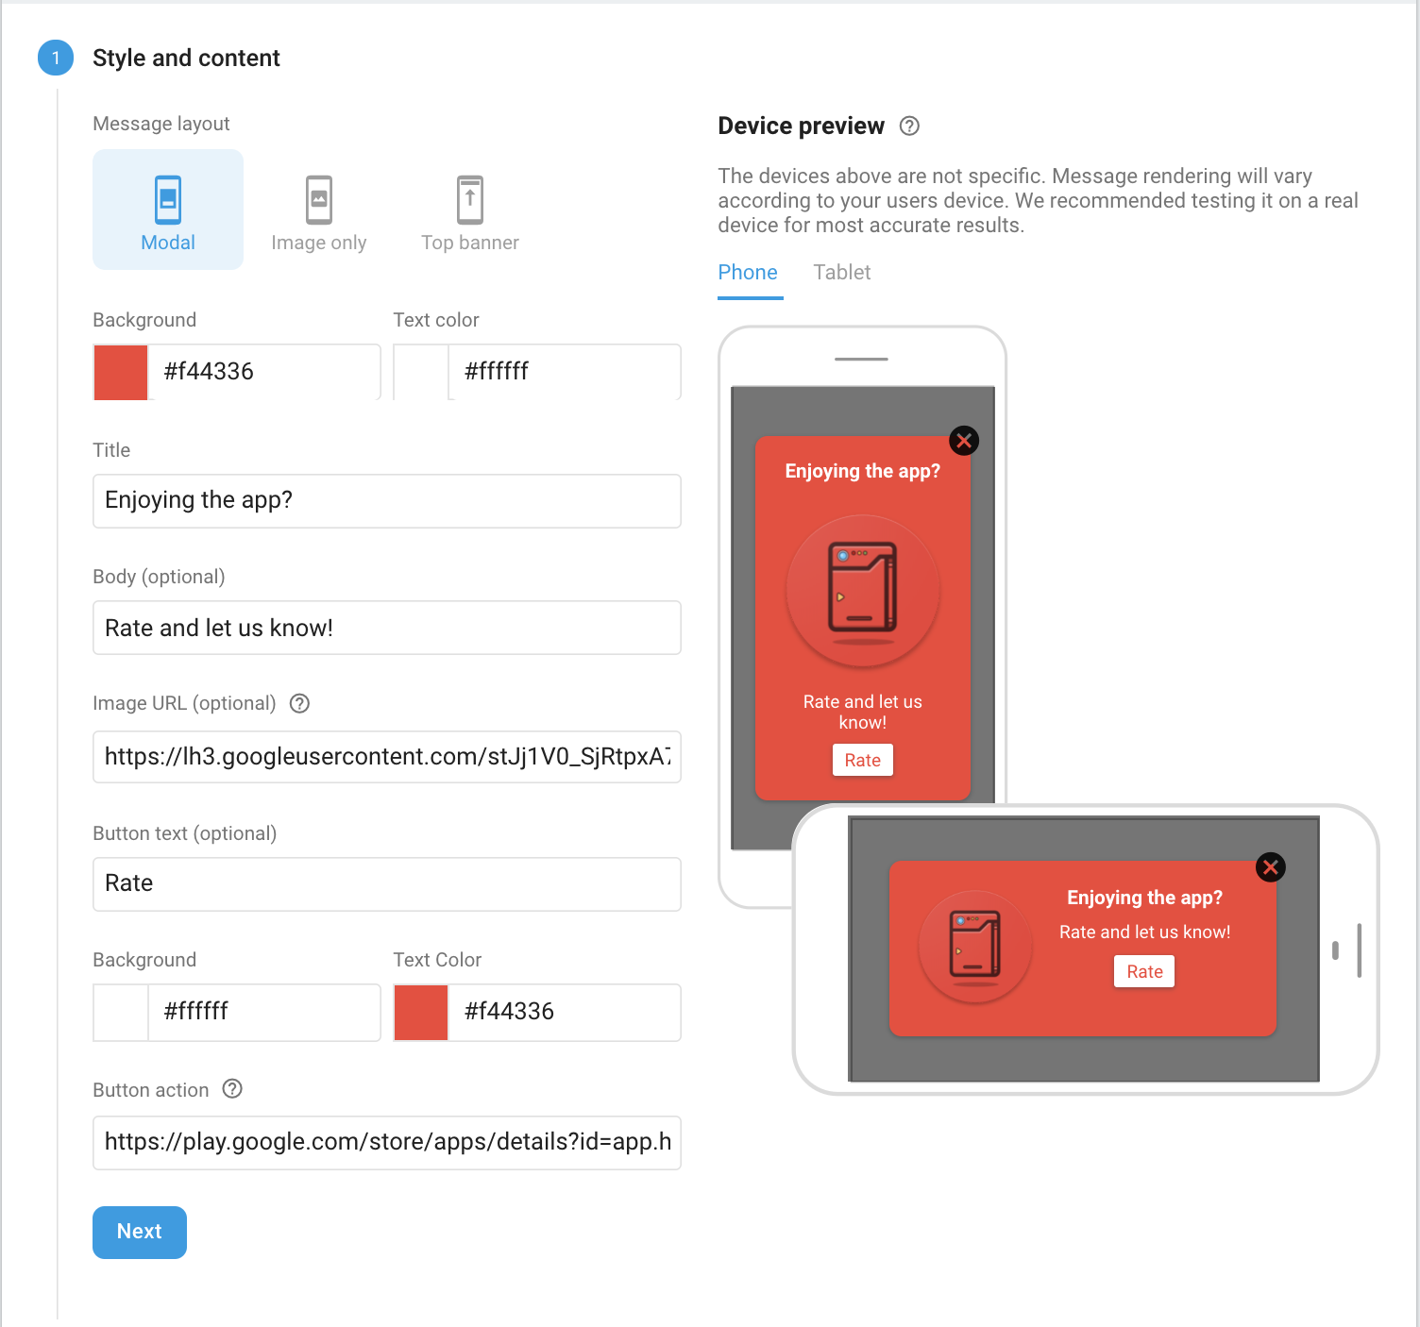
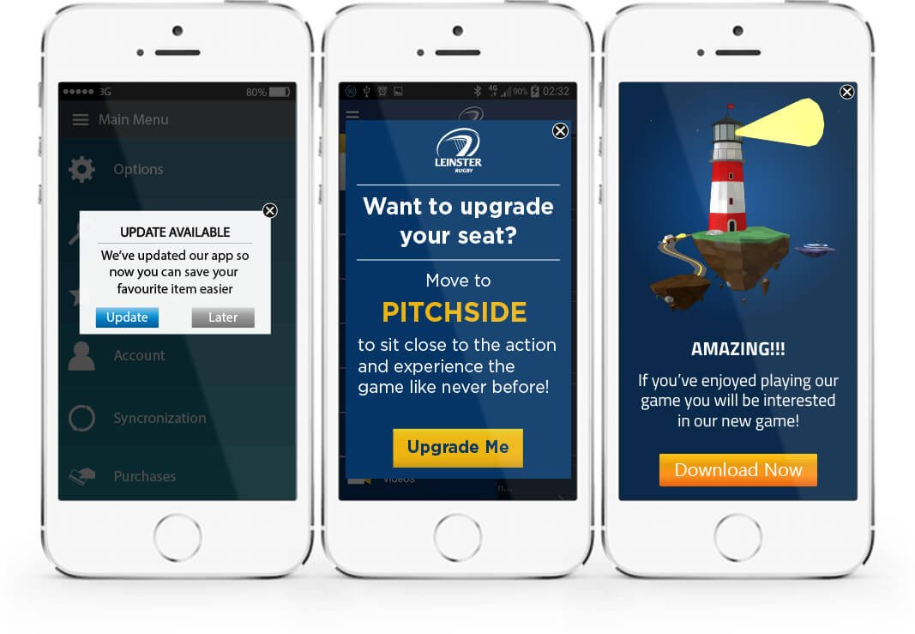
Firebase In-App Messaging

Slide 26
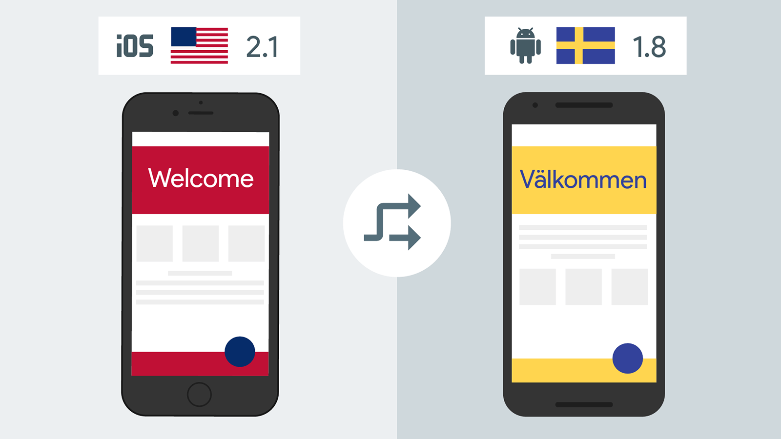
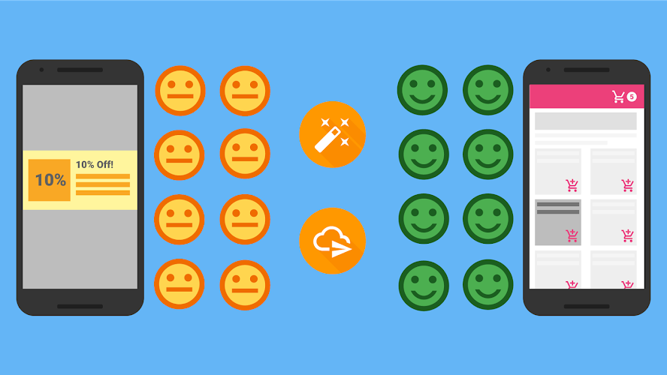
Firebase
Remote Config
dynamic changes to your app’s behavior and appearance without having to publish an update to your app

Slide 27
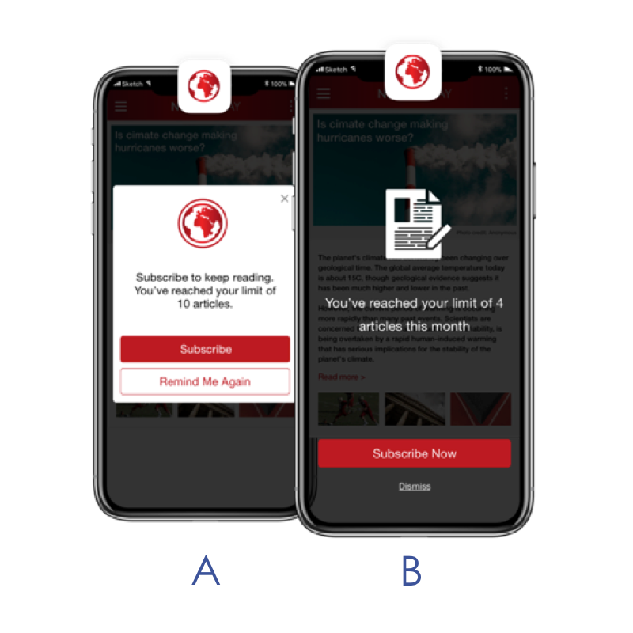
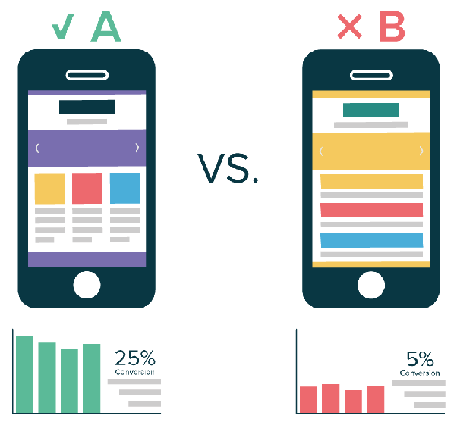
Firebase A/B Testing
Notes:
set up an experiment and conduct it on a handful of users before making a decision. This is wise, because making an uninformed decision about a change to your app

Slide 28
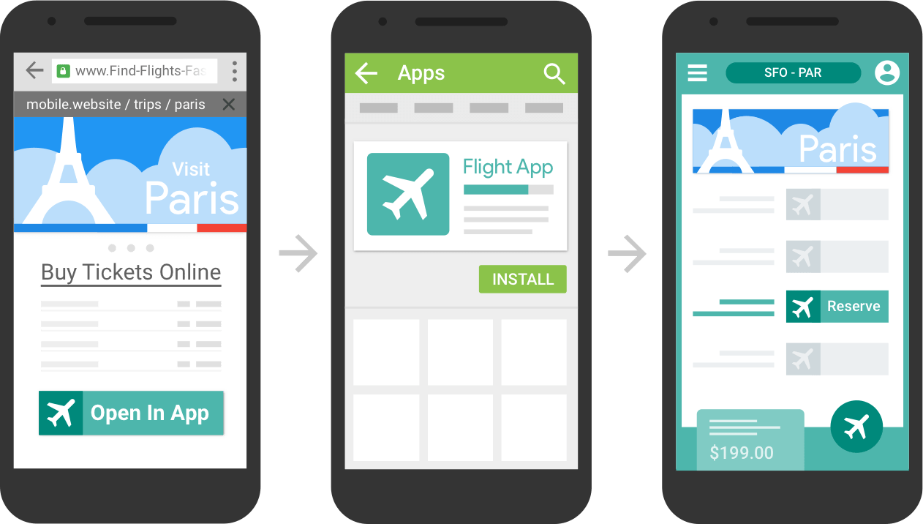
Firebase Dynamic Links
builds on the existing concept of a “deep link” that launches your app to a particular screen or customized experience

Slide 29
Improve your app
stability and performance

Slide 30
Improve your app
Test Lab — scalable and automated app testing on cloud-hosted devices
Crashlytics — get clear, actionable insight into your app’s crashes
Performance Monitoring — gain insight into your app’s performance issues

Slide 31
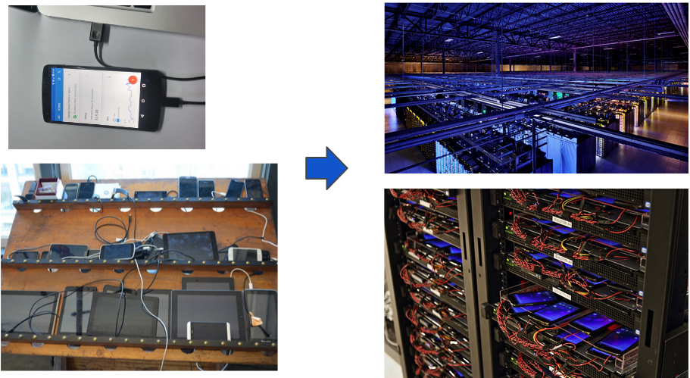
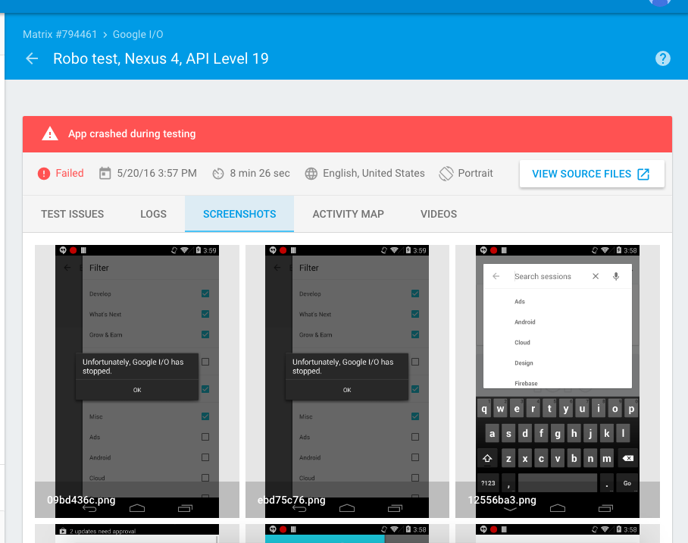
Firebase Testlab

Slide 32
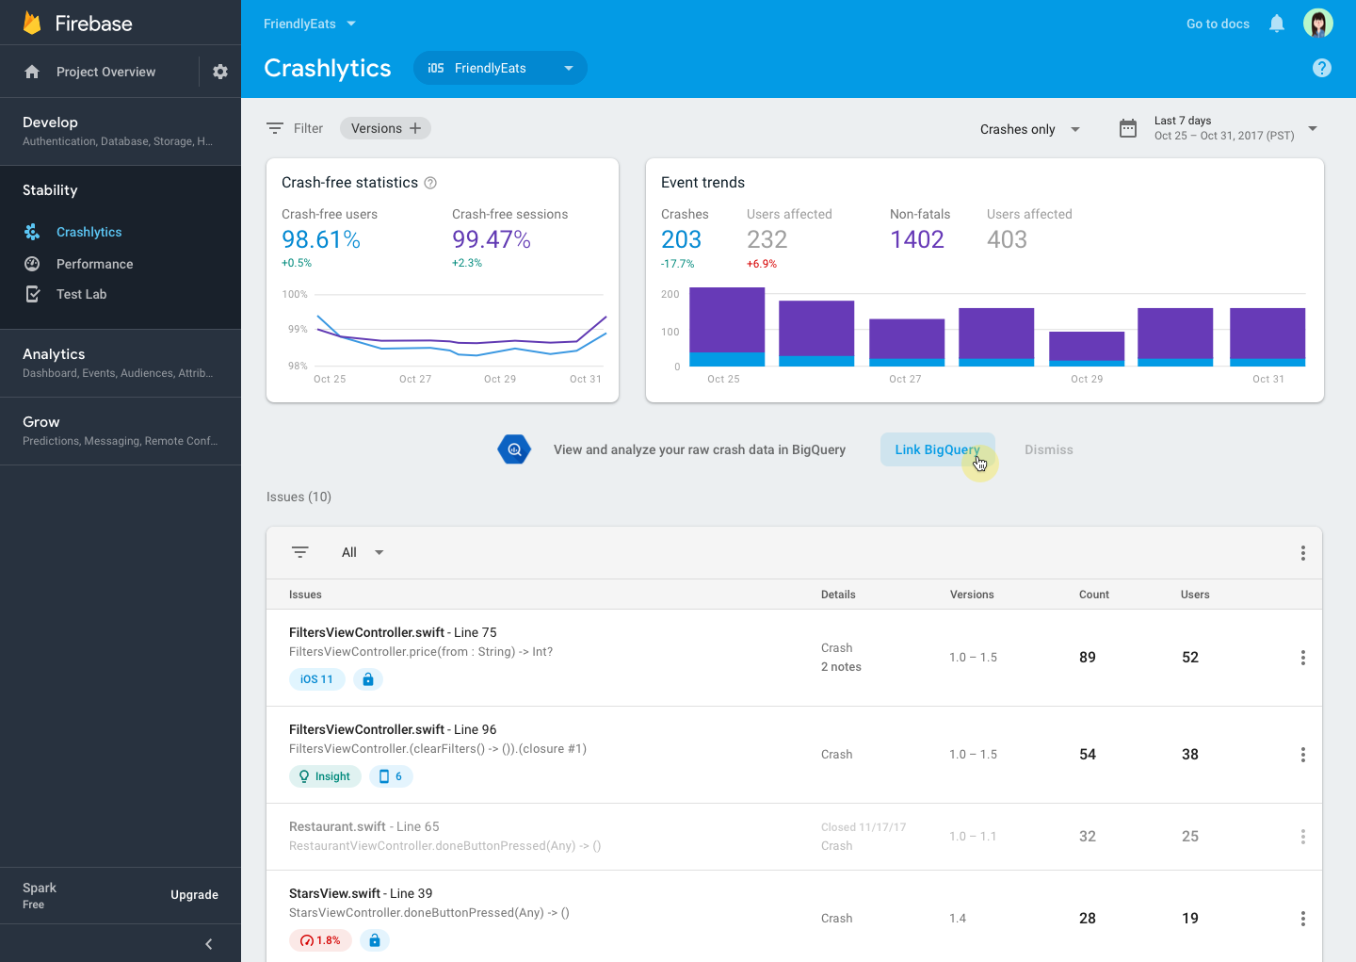
Firebase Crashlytics
Notes:
It’s even integrated with Analytics, so you can measure how crashes are affecting the way users use your app (possibly by uninstalling it).

Slide 33
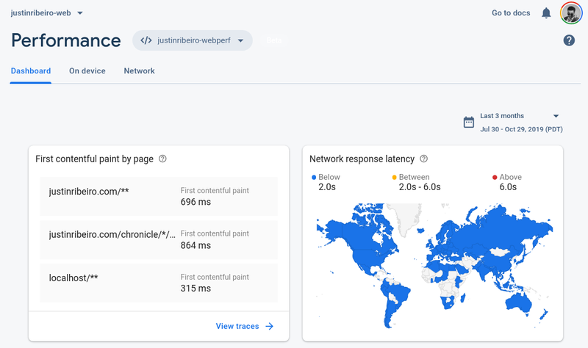
Firebase Performance Monitoring
Notes:
gives you insights into your app’s performance issues, from your users’ point of view, by measuring its HTTP requests, startup time, and other code using its API.

Slide 34
Demo App
Firebase Authentication

Slide 35
You can use Firebase Authentication to let your users authenticate with Firebase using their email addresses and passwords, and to manage your app's password-based accounts.

Slide 36
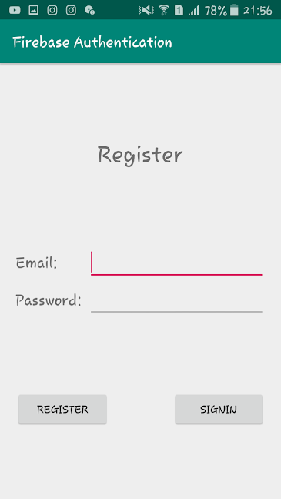
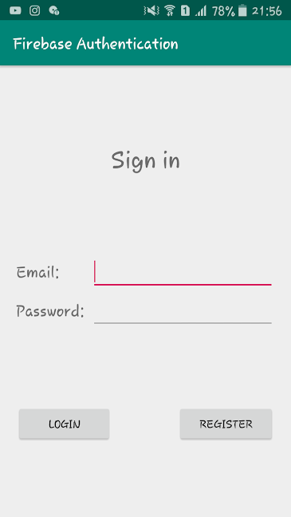
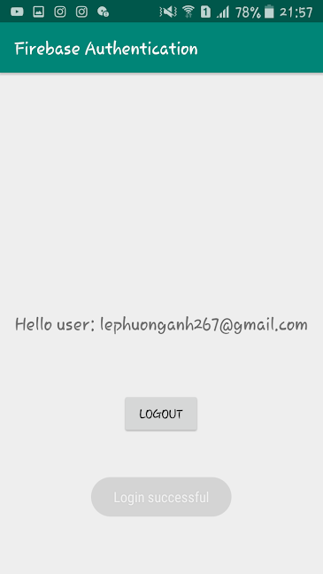
Features
Create new account with email-password
Signin Authenticated
Signout

Slide 37
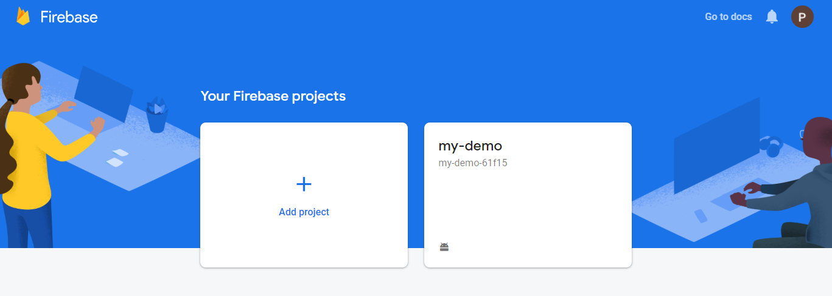
Create New Firebase Project
https://console.firebase.google.com/

Slide 38
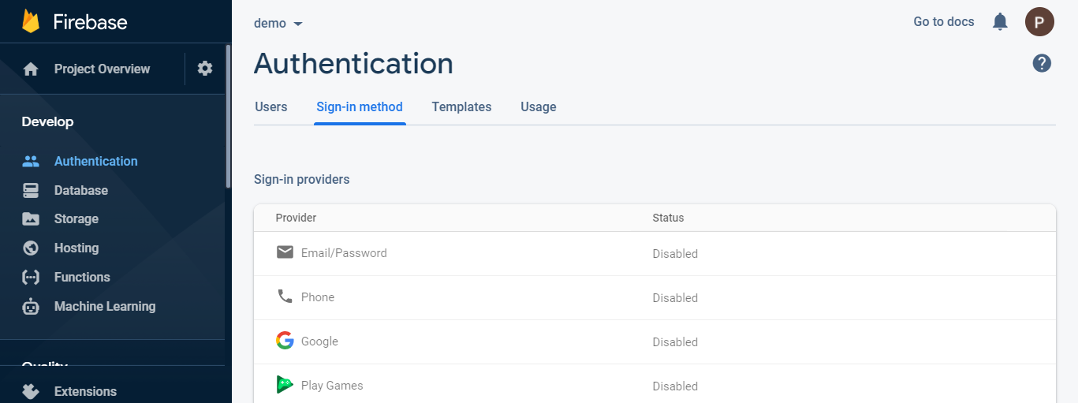
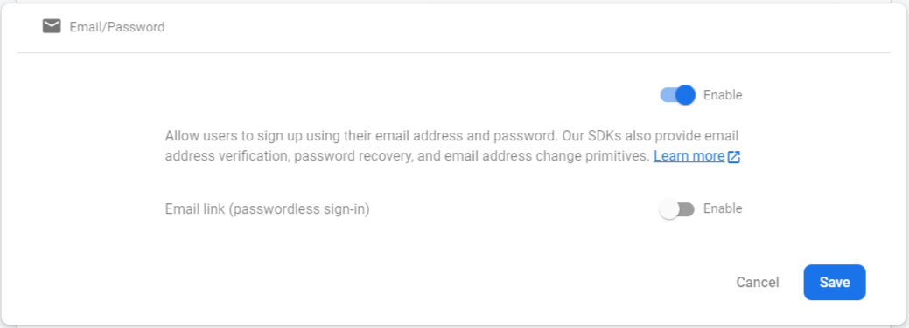
Setup Signin Method

Slide 39
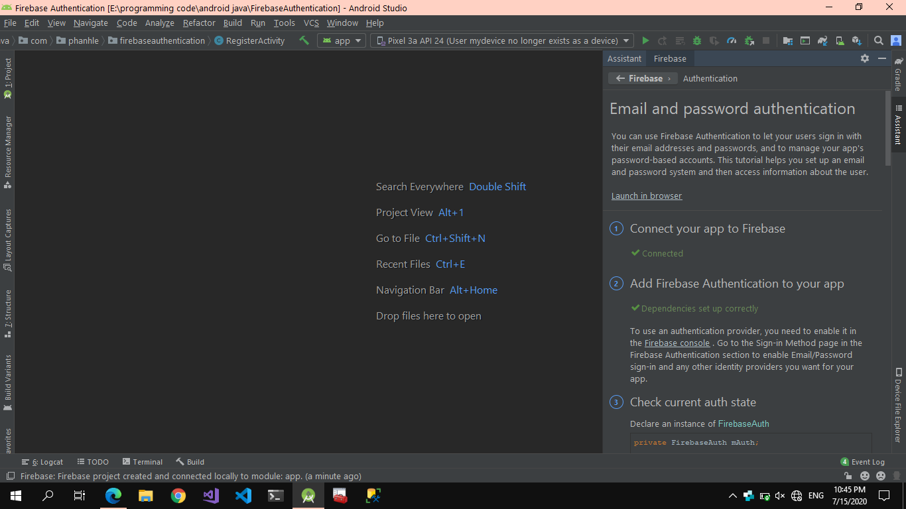
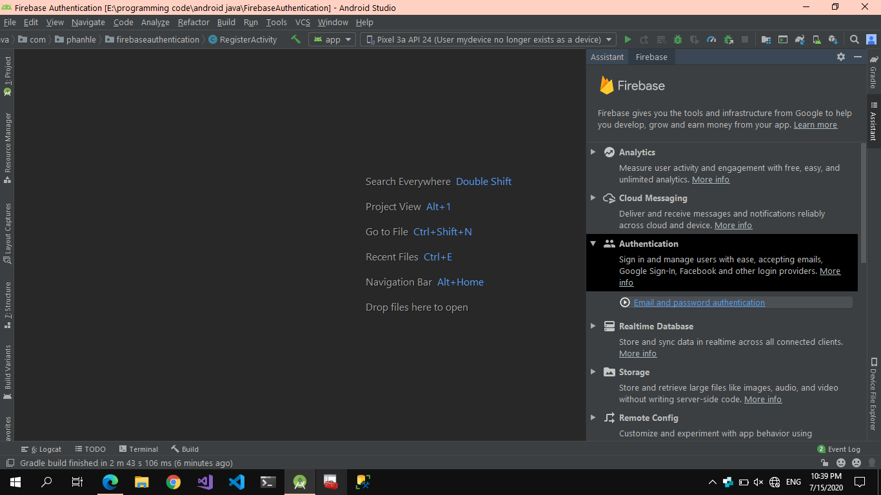
Connect Firebase to your App
Add Firebase using the Firebase Assistant (in Android Studio) >Tools>Firebase https://firebase.google.com/docs/android/setup#assistant

Slide 40
Create and Initialize Firebase Auth Instance
private FirebaseAuth mAuth;
// ...
// Initialize Firebase Auth
mAuth = FirebaseAuth.getInstance();

Slide 41
Create new account with email-password
mAuth.createUserWithEmailAndPassword(email, password)
.addOnCompleteListener(this, new OnCompleteListener<AuthResult>() {
@Override
public void onComplete(@NonNull Task<AuthResult> task) {
if (task.isSuccessful()) {
startActivity(MainActivity.class);
} else {
Log.w(TAG, "createUserWithEmail:failure", task.getException());
Toast.makeText(RegisterActivity.this, "Authentication failed.",
Toast.LENGTH_SHORT).show();
}
}
});

Slide 42
SignIn
mAuth.signInWithEmailAndPassword(email, password)
.addOnCompleteListener(this, new OnCompleteListener<AuthResult>() {
@Override
public void onComplete(@NonNull Task<AuthResult> task) {
if (task.isSuccessful()) {
Log.d(TAG, "signInWithEmail:success");
startActivity(MainActivity.class);
} else {
Log.w(TAG, "signInWithEmail:failure", task.getException());
Toast.makeText(LoginActivity.this, "Authentication failed.",
Toast.LENGTH_SHORT).show();
}
}
});

Slide 43
Signout
FirebaseAuth.getInstance().signOut();

Slide 44
Access User Account Information
FirebaseUser user = FirebaseAuth.getInstance().getCurrentUser();
if (user != null) {
// User is signed in
} else {
// No user is signed in
}
String email = user.getEmail();

Slide 45
Thanks for watching!
References:
https://medium.com/firebase-developers/what-is-firebase-the-complete-story-abridged-bcc730c5f2c0
https://wiki.matbao.net/firebase-la-gi-giai-phap-lap-trinh-khong-can-backend-tu-google/
https://firebase.google.com/
https://cloud.google.com/storage/docs/key-terms#buckets
https://medium.com/mobiletech/firebase-authentication-sample-371b5940ba93

